Slide 1
Smoothing Splines
Team 1-3
Jake Smith, Ye Chen, William Jackson

Slide 2
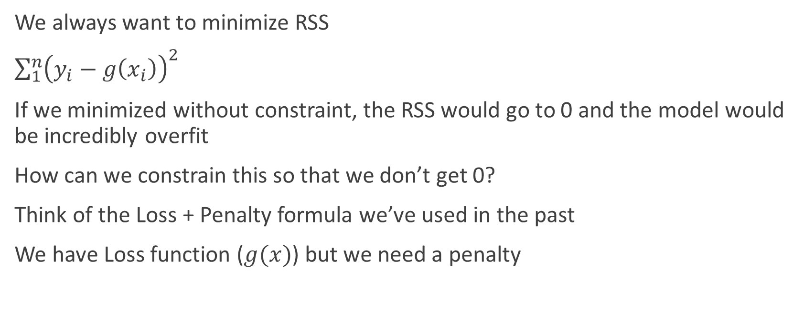
Background
We always want to minimize RSS
$\sum_{1}^{n}{{\left(y_{i}−g\left(x_{i}\right)\right)}^{2}}$
If we minimized without constraint, the RSS would go to 0 and the model would be incredibly overfit
How can we constrain this so that we don’t get 0?
Think of the Loss + Penalty formula we’ve used in the past
We have Loss function ($g(x)$) but we need a penalty

Slide 3
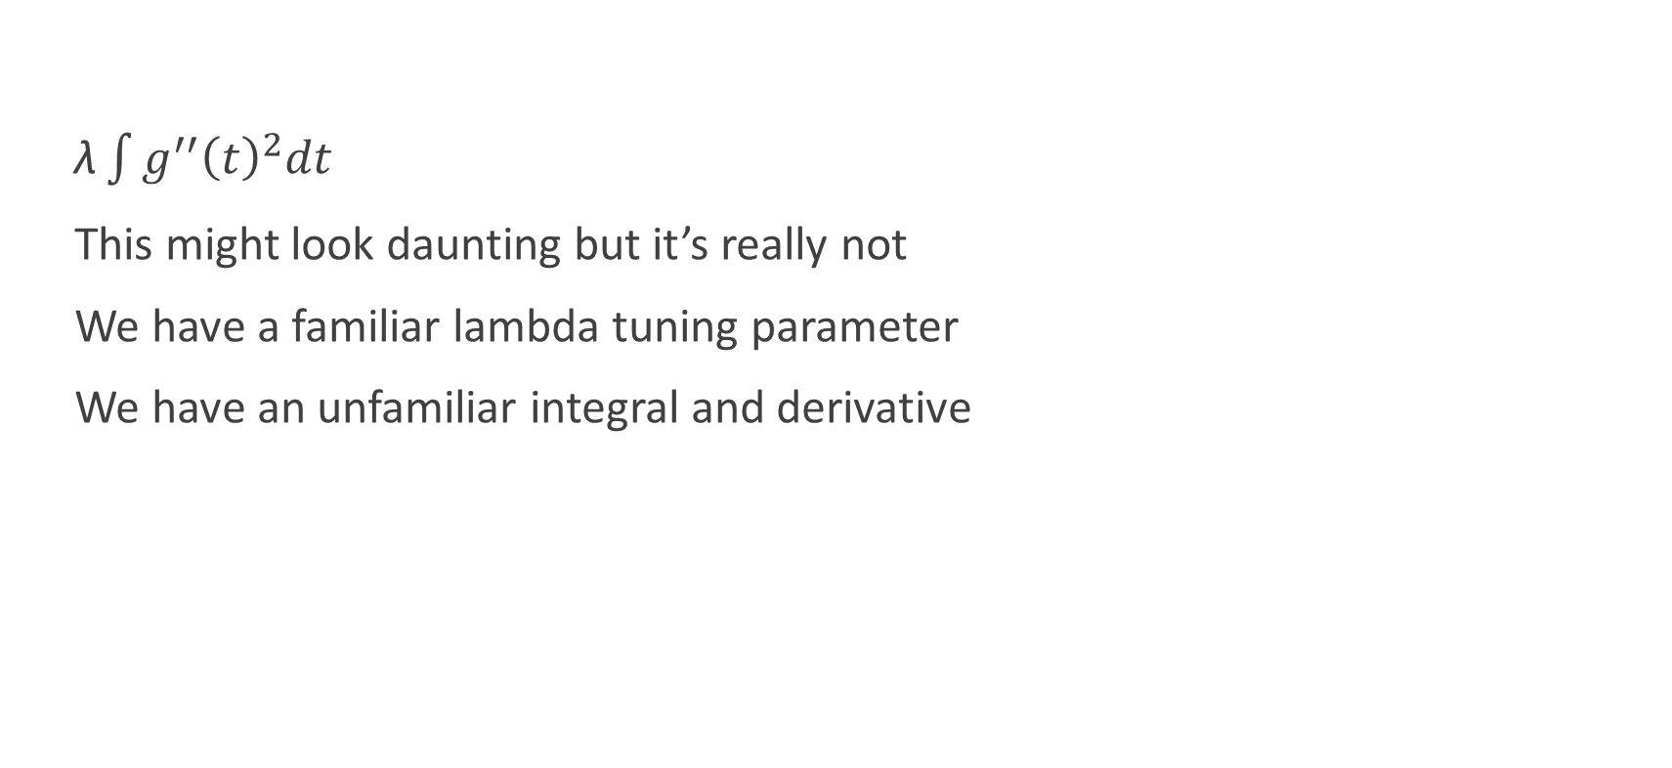
Penalty
$\text{λ}\int{{g^{′′}\left(t\right)}^{2}dt}$
This might look daunting but it’s really not
We have a familiar lambda tuning parameter
We have an unfamiliar integral and derivative

Slide 4
First Derivative
1
1
1
0
0

Slide 5
Second Derivative
?
No change in slope
?
1
?
1
1
0
0

Slide 6
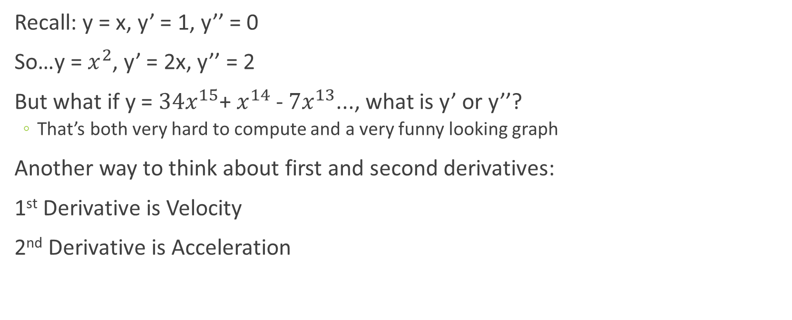
Derivatives Interpreted
Recall: y = x, y’ = 1, y’’ = 0
So…y = $x^{2}$, y’ = 2x, y’’ = 2
But what if y = ${34x}^{15}$+ $x^{14}$- ${7x}^{13}$..., what is y’ or y’’?
That’s both very hard to compute and a very funny looking graph
Another way to think about first and second derivatives:
1st Derivative is Velocity
2nd Derivative is Acceleration

Slide 7
Calculus Interpreted
Integrating is the opposite of deriving
It becomes the summation over the whole range of the curve.
As there are more changes in the second derivative, the integral gets larger.
As the integral gets larger the penalty associated increases as well.

Slide 8

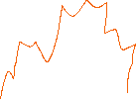
Graph Examples
y = $x^{2}$
y’ = 2x
?
y’’ = 2
?

Slide 9
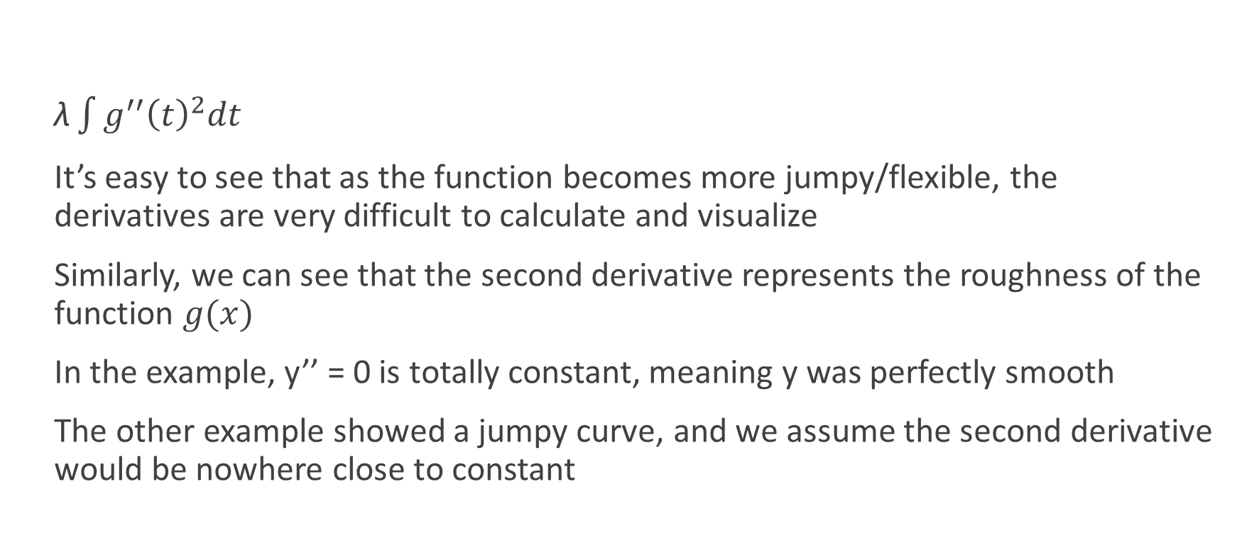
Penalty
$\text{λ}\int{{g^{′′}\left(t\right)}^{2}dt}$
It’s easy to see that as the function becomes more jumpy/flexible, the derivatives are very difficult to calculate and visualize
Similarly, we can see that the second derivative represents the roughness of the function $g(x)$
In the example, y’’ = 0 is totally constant, meaning y was perfectly smooth
The other example showed a jumpy curve, and we assume the second derivative would be nowhere close to constant

Slide 10
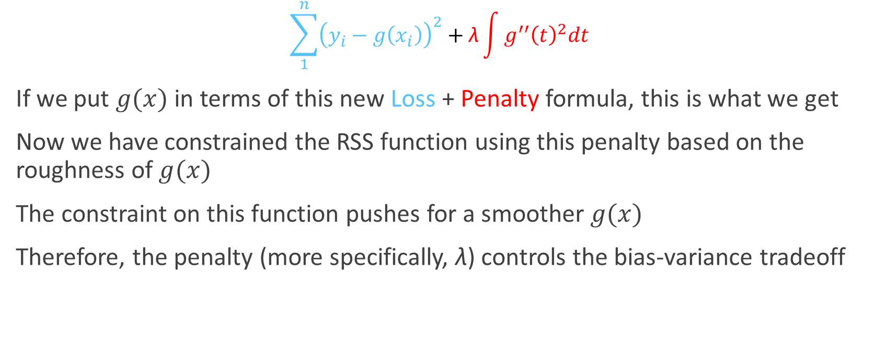
Smoothing Constraint
$$\sum_{1}^{n}{{\left(y_{i}−g\left(x_{i}\right)\right)}^{2}+\text{λ}\int{{g^{′′}\left(t\right)}^{2}dt}}$$
If we put $g(x)$ in terms of this new Loss + Penalty formula, this is what we get
Now we have constrained the RSS function using this penalty based on the roughness of $g(x)$
The constraint on this function pushes for a smoother $g(x)$
Therefore, the penalty (more specifically, $\text{λ}$) controls the bias-variance tradeoff

Slide 11
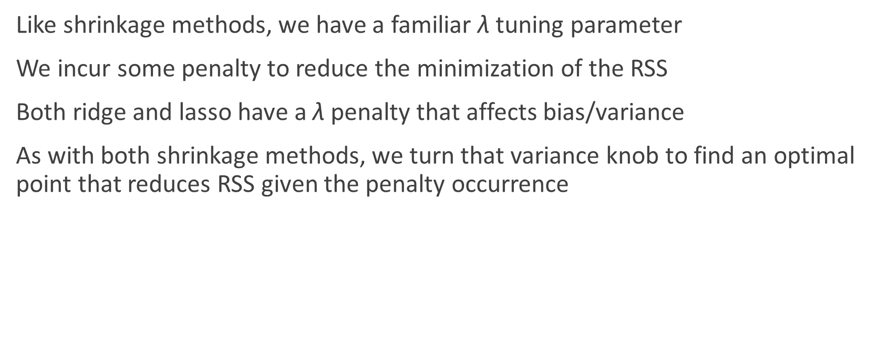
Similarities to Shrinkage
Like shrinkage methods, we have a familiar $\text{λ}$ tuning parameter
We incur some penalty to reduce the minimization of the RSS
Both ridge and lasso have a $\text{λ}$ penalty that affects bias/variance
As with both shrinkage methods, we turn that variance knob to find an optimal point that reduces RSS given the penalty occurrence

Slide 12
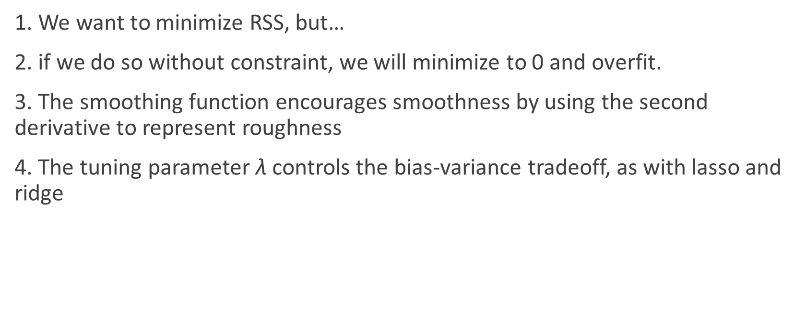
Conclusions So Far
1. We want to minimize RSS, but…
2. if we do so without constraint, we will minimize to 0 and overfit.
3. The smoothing function encourages smoothness by using the second derivative to represent roughness
4. The tuning parameter $\text{λ}$ controls the bias-variance tradeoff, as with lasso and ridge

Slide 13
Quiz

Slide 14
Question 1
What are we aiming to minimize with smoothing splines?
A. KNN
B. RSS
C. LSE
D. PCA

Slide 15
Question 2
Where else have we used a lambda parameter to tune our model?
A. Ridge Regression
B. KNN
C. Lasso
D. MapReduce

Slide 16


Question 3
What is the second derivative of the following expression?
A. ${12x}^{2}+4x −6$
B. $7x+2$
C. $24x+4$
D. $13$
$${4x}^{3}+{2x}^{2}−6x −2$$

Slide 17
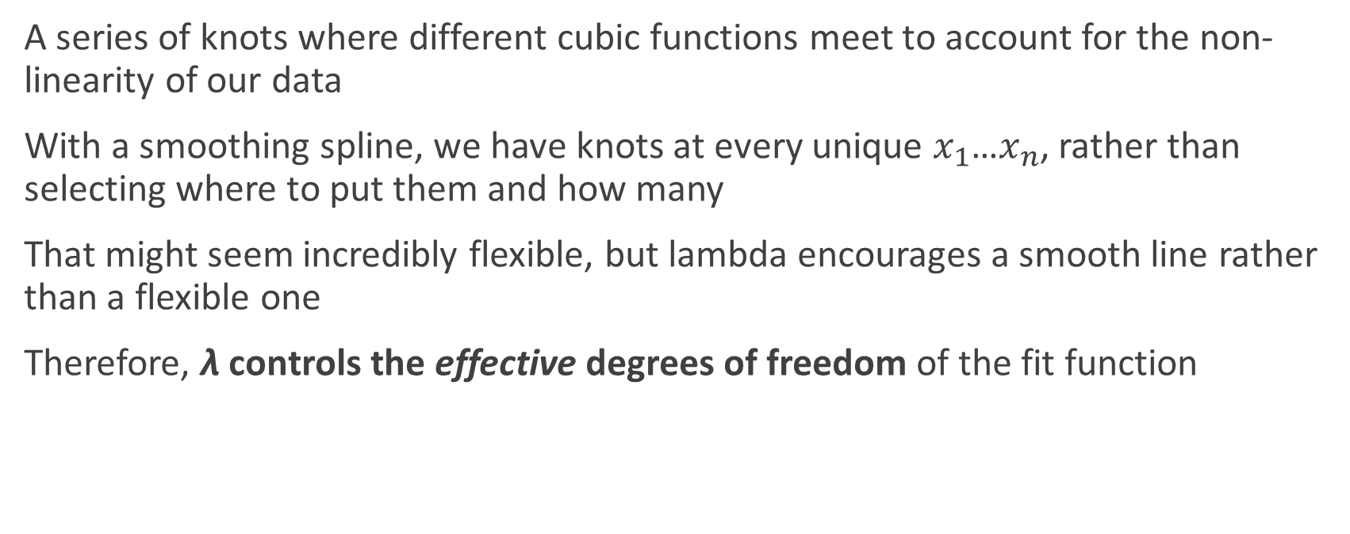
Splines
A series of knots where different cubic functions meet to account for the non-linearity of our data
With a smoothing spline, we have knots at every unique $x_{1}$…$x_{n}$, rather than selecting where to put them and how many
That might seem incredibly flexible, but lambda encourages a smooth line rather than a flexible one
Therefore, $\text{λ}$ controls the effective degrees of freedom of the fit function

Slide 18
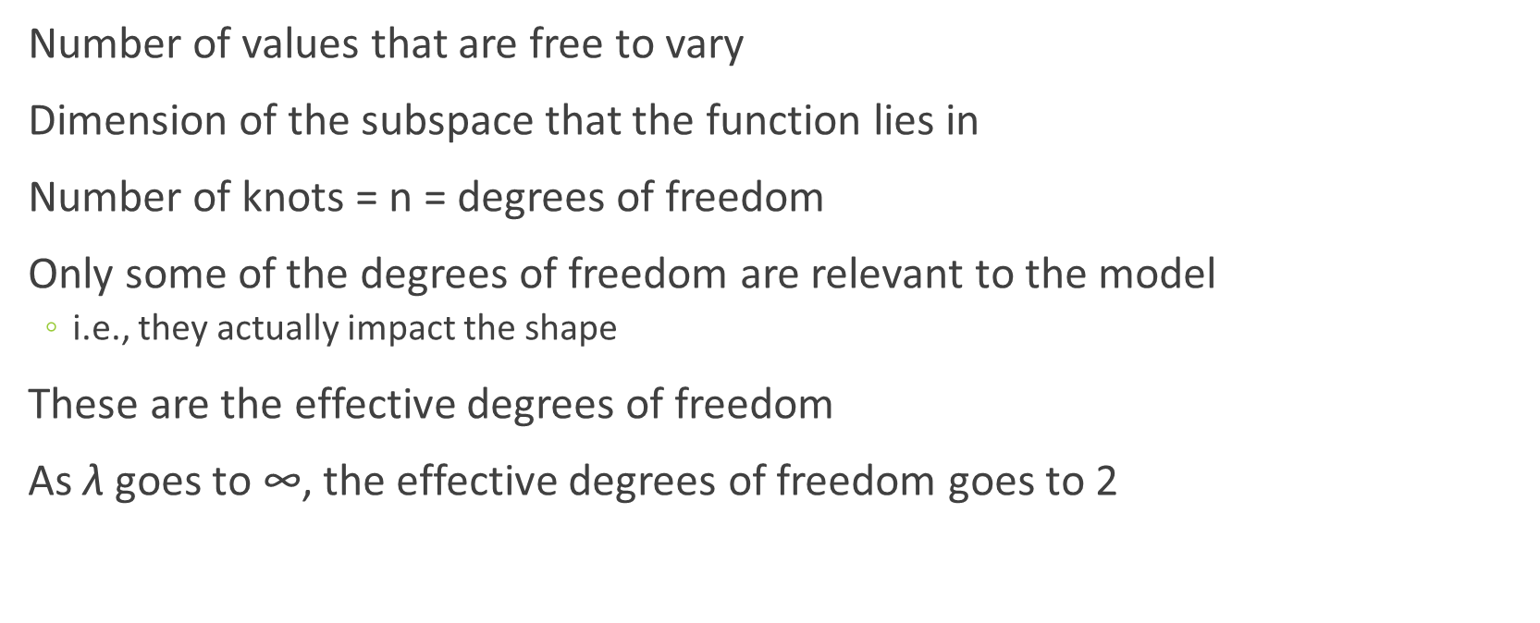
Degrees of Freedom
Number of values that are free to vary
Dimension of the subspace that the function lies in
Number of knots = n = degrees of freedom
Only some of the degrees of freedom are relevant to the model
i.e., they actually impact the shape
These are the effective degrees of freedom
As $\text{λ}$ goes to ∞, the effective degrees of freedom goes to 2

Slide 19
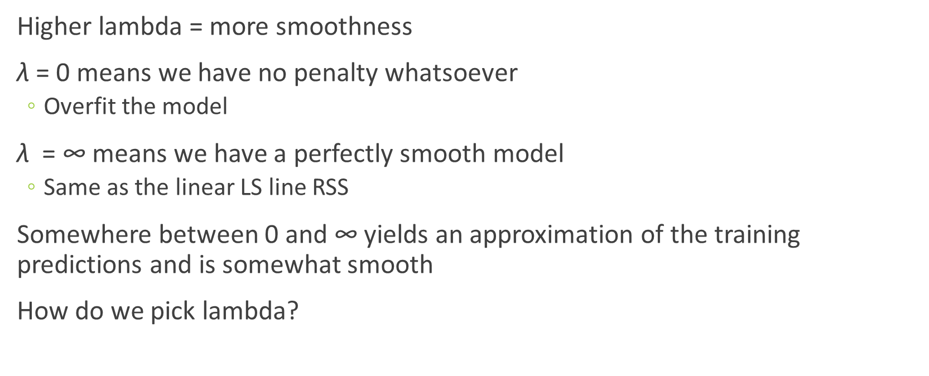
Lambda
Higher lambda = more smoothness
$\text{λ}$ = 0 means we have no penalty whatsoever
Overfit the model
$\text{λ}$ = ∞ means we have a perfectly smooth model
Same as the linear LS line RSS
Somewhere between 0 and ∞ yields an approximation of the training predictions and is somewhat smooth
How do we pick lambda?

Slide 20
Choosing Lambda/DF
How have we iterated through multiple possible values of things in the past?
Cross-validation (LOOCV) provides us with the optimal value for lambda
The next slide shows an example of LOOCV vs arbitrary selection
Remember that when we select lambda we are influencing the effective degrees of freedom

Slide 21

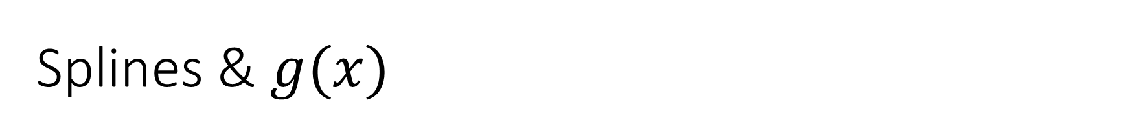
Splines & $g(x)$
$g(x)$ is special
Piecewise cubic polynomial function with knots at all unique $x_{1}$… $x_{n}$
Continuous derivatives at all knots
Linear in region outside extreme knots
Different than other spline techniques because $\text{λ}$shrinks the function

Slide 22
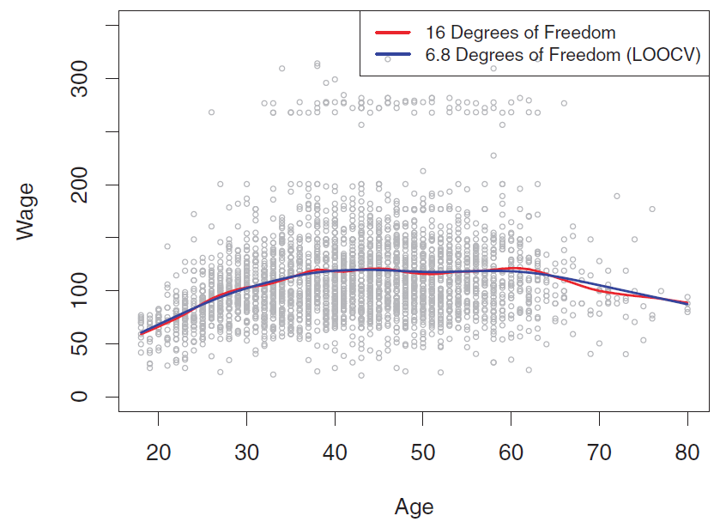
Lambda Selection
16 degrees of freedom (randomly selected) yields a model similar to that of the LOOCV-selected 6.8 degrees of freedom, so we go with the simpler model

Slide 23
Local Regression

Slide 24
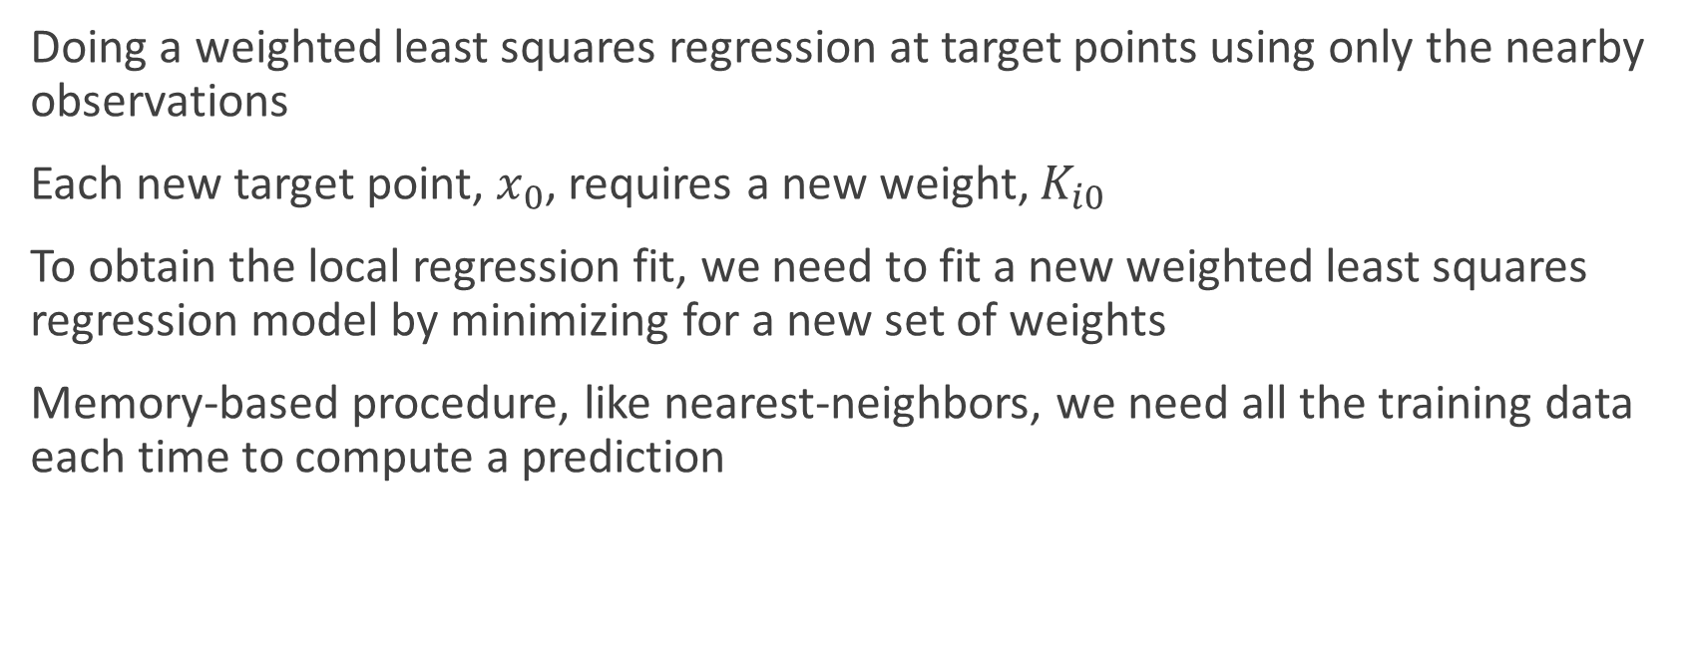
What is local regression?
Doing a weighted least squares regression at target points using only the nearby observations
Each new target point, $x_{0}$, requires a new weight, $K_{i0}$
To obtain the local regression fit, we need to fit a new weighted least squares regression model by minimizing for a new set of weights
Memory-based procedure, like nearest-neighbors, we need all the training data each time to compute a prediction

Slide 25
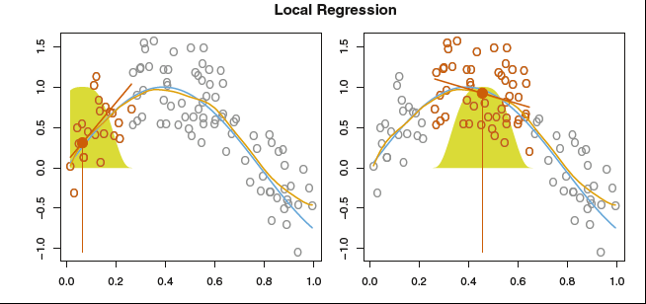

Slide 26
Steps to perform a local regression
Choose how to define the weighting function K
Fit a linear, constant, or quadratic regression
Fit span s, like the tuning parameter lambda, which controls the flexibility of the non-linear fit

Slide 27


Weight function
Tricube weighted function is commonly used
You can use any weight function as long as it satisfies these properties listed by Cleveland

Slide 28
More on Span
Smaller value means the more local and wigglier our fit
Larger value leads to a global fit. Essentially performing a weighted linear regression because we are using all of the training observations
Use CV to choose the best s

Slide 29
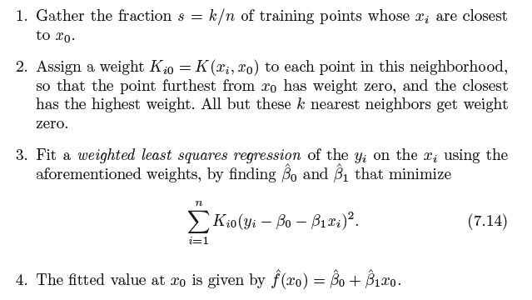
Algorithm for X = x0

Slide 30
Quiz

Slide 31
Question 1
Why is local regression computationally intensive?
A. Your computer is poor quality
B. Code is badly optimized
C. The method of use is poorly grounded in science
D. You’re recalculating news weights at targeted points

Slide 32
Question 2
What is the most important step in local regression?
A. Finding span
B. Installing Spark
C. Selecting the number of knots
D. Calculating weights

Slide 33
Question 3
How are smoothing splines and local regression similar?
A. Both require the derivatives to be continuous
B. Both include tricube weighted regression
C. Both use segments of curves pieced together to make an overall model
D. Both have a lambda parameter

Slide 34
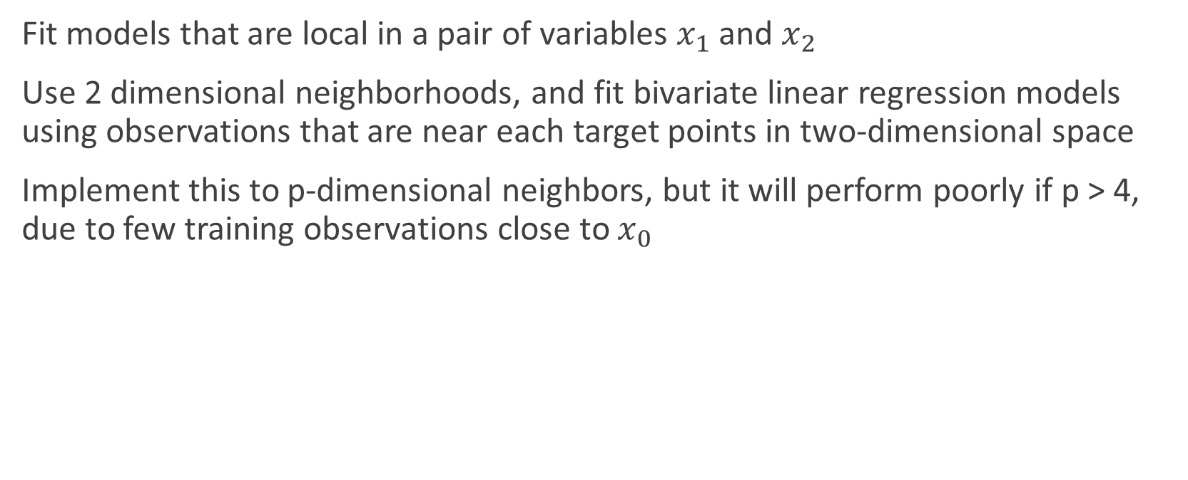
Generalizing Local Regression
Fit models that are local in a pair of variables $x_{1}$ and $x_{2}$
Use 2 dimensional neighborhoods, and fit bivariate linear regression models using observations that are near each target points in two-dimensional space
Implement this to p-dimensional neighbors, but it will perform poorly if p > 4, due to few training observations close to $x_{0}$

Slide 35
Pros
Simple method
Does not require a function to fit a model to all the data
Only need to provide a smoothing parameter and the degree of the local polynomial
Flexible, ideal for modeling complex processes which no theoretical models exist

Slide 36
Cons
Requires fairly dense sampled data set in order to produce good models
Does not produce a regression function that is easily represented by a formula, difficult to interpret results
Sensitive to outliers, like other least squares methods
Computationally intensive

Slide 37
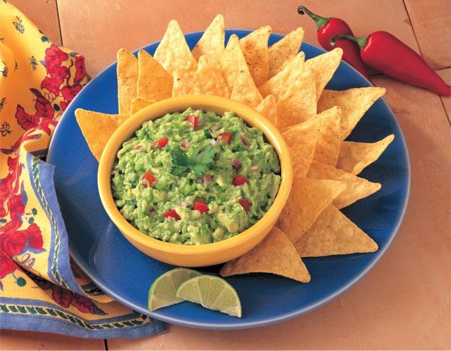
Group Exercise
Predict large bags on average price
Try both smoothing splines and local regression
You don’t have to use CV for local regression, just use 0.2 and 0.5 for span
First team to show correct solutions wins guacamole

